Slide 1
Quantifying the impacts of hospitals increasing single bed room provision
Andy Hood | Analytics Manager | Strategy Unit | May 2025

Slide 2
1. Executive Summary

Slide 3
1.1 (1)
The NHP program advocates for a majority single-bedded inpatient room (SBR) design for new hospitals.
There is a planning assumption that doing so will reduce average inpatient lengths of stay (circa 12%).
Given the absence of strong and consistent evidence to support this, our challenge was to quantify changes in LoS and a range of other potential impacts for 7 natural experiments in SBR between 2010 and 2022.
We have identified 12 impact measures from routinely collected or published data to assess for pre-post effects.
We used an analytical approach called Causal Impact Analysis (CIA) to detect and quantify those pre-post changes in trend.
The results of our analysis, much like the published literature, are mixed. A recent qualitative lookback exercise with (many of the same) hospitals also confirmed on-the-ground feelings of both positive patient impacts and operational challenges and risks related to SBR switches.

Slide 4
1.2 (2)
There were no overall significant findings in relation to impacts of changes to SBR provision, although there were instances of significant impact on some measures at individual sites. There are contextual factors not accounted for within our analysis which will likely have exacerbated or mitigated the effects.
For bed occupancy, emergency readmissions, cleaning costs and all health and safety measures there were either positive effects or no significant change. A mixture of positive and negative effects were seen for length of stay, waiting time, patient experience, and staff experience measures. Where there were immediate positive or negative impacts on a metric, these often regressed back towards prior levels over the longer-term (2 years).
Reduced length of stay could potentially help offset additional costs associated with single room hospitals, however, at general acute hospitals there was no significant change in length of stay (7% reduction (-17% to 2% 95% CI)). At general acute hospitals the proportion of staff recommending their trust as a place to work significantly decreased by 15% (-23% to -6% 95% CI) and staff sickness absences increased by 6% (1% to 12% 95% CI).

Slide 5
1.3 (3)
For planning purposes, the NHP may want to take a more conservative approach to modelling the impact on LoS of SBR but also consider other potential efficiency gains i.e. reduced waiting times, reduction in falls/injuries and infections. Additionally, acknowledging the potential adverse impacts on staff experiences, qualitative monitoring of impacts would aid in implementation and mitigation strategies.
For both SBR impacts and broader programme evaluation, a prospective monitoring framework of these indicators and more would support and develop the evidence-base for hospital design and builds in the future.

Slide 6
2. Introduction, approach, summary and recommendations

Slide 7
2.1 Introduction
Since it’s inception, the New Hospital Programme (NHP) has advocated for single bedded inpatient rooms (SBR). The grounds for this are based on a range of guidance, evidence and previous policy statements of intent. Whilst that position is unequivocal, there is uncertainty around the quantification of impacts of such a change and thus the assumptions that feed into demand and capacity models and economic business cases for current and future new hospital developments.
Specifically, a starting assumption was that a length of stay reduction of 12% was likely for all new SBR facilities compared to prior trends. This assumption was criticised by the national audit office (NAO) (Office 2023) in the face of a mixed evidence base.
It is the express aim of this analysis therefore to quantify the range of likely impacts for length of stay and a basket of other measures across patient & staff experience, productivity and health & safety.

Slide 8
2.2 Approach
Previous literature reviews and general searches were undertaken to identify potential impact factors.
Identified relevant measures or proxy measures from publicly available data and routine data sources.
Included only those with sufficient time series and of acceptable data quality into final impact framework.
Cleansed and compiled all the data into time series format.
Identified ‘control’ sites and providers to compare to our natural experiment sites - matching according to hospital function, size, case-mix and admission ratio’s.
Performed causal impact analysis on the pre and post intervention periods to detect the nature and scale of impacts for each natural experiment.
Aggregated findings for the non-specialist hospitals.

Slide 9
2.3 Summary of key findings (1)
Our results are generally not consistent within indicators and across hospital sites. This inconsistency is reflective of the findings from published literature. Only one impact measure moved in the same direction across all (eligible) sites - staff turnover decreasing – though no site results were significant, and three measures were significant at the pooled general-acute hospital level – patient experience increasing, staff sickness increasing and staff satisfaction decreasing.
This suggests that there are many factors in the hospital design, systems, policies and cultures that are important. Switching to single bedroom hospitals without considering these other factors would not necessarily have a positive effect on outcomes nor mitigate any likely risks.

Slide 10
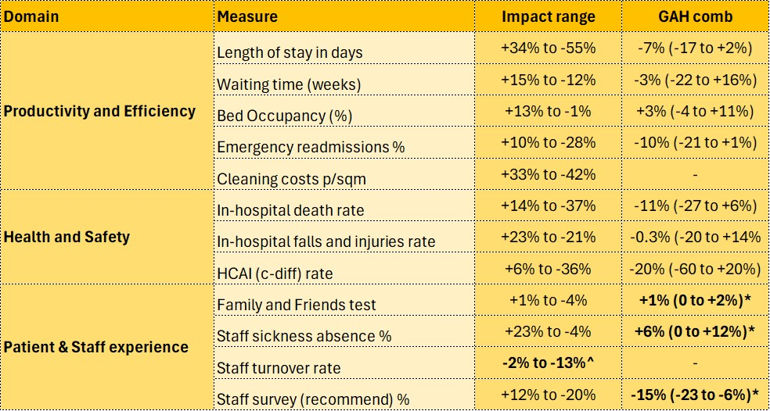
2.4 Summary of key findings (2)
The table across demonstrates the range of impacts across all new hospital sites for each impact measure as well as point estimates for pooled general acute sites.
^ Point estimate of impacts for all study sites were the same side of no effect.
* The pooled (general acute sites) impact was significantly different to no effect.

Slide 11
2.5 Limitations
Data quality and consistency issues over time
No below site-level analysis possible (e.g. treatment specialty/service)
Poor sensitivity/specificity of some of our proxy measures
Dose-response effects are not possible to ascertain (e.g. an x% change in SBR leads to a y% change in impact A)
Covid 19 bias in some of the pre and post trends at certain sites
Small pool of control sites and lack of comparability (specialist sites)
Model fit and large credible intervals

Slide 12
2.6 Recommendations
Exercise caution when accounting for these impacts in business planning - use a range and suitable benchmark.
Develop an evaluation framework from (some of) these measures, process indicators and wider evidence (logic model).
Include qualitative survey measures for patients and staff (free text for thematic analysis) to support ongoing mitigation.
Capture information on design, systemic and cultural factors that may also have bearing on these impacts.
Start collecting data well before the change in bed provision and at least monthly.
System dynamics modelling could aid understanding of multi-factorial productivity impacts (i.e. waiting lists, length of stay and bed occupancy).
Undertake length of stay sub-group analysis i.e. by clinical and patient groups.

Slide 13
3. The impact framework

Slide 14
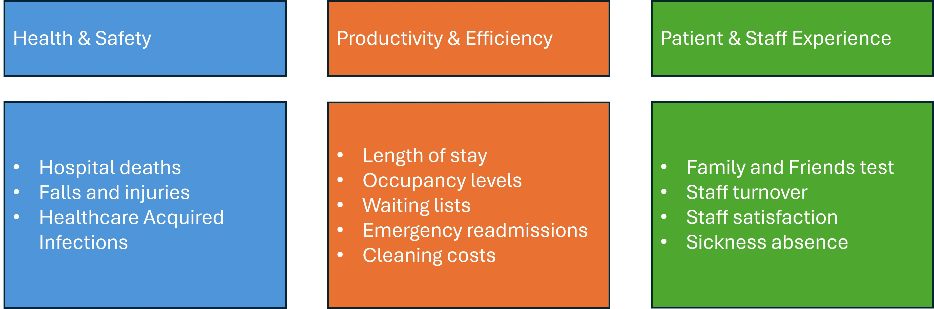
3.1 Overview

Slide 15
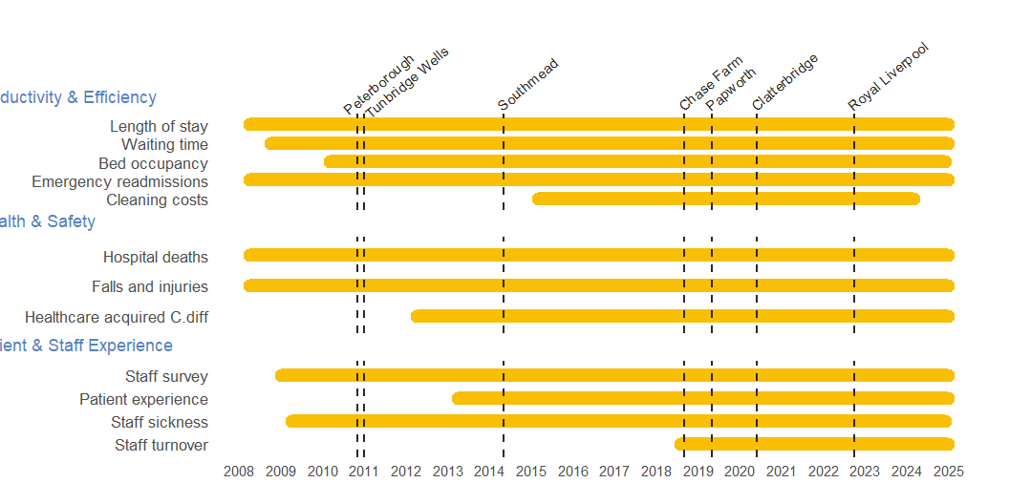
3.2 Indicator availability and time of SBR changes by site

Slide 16
4. The hospitals

Slide 17
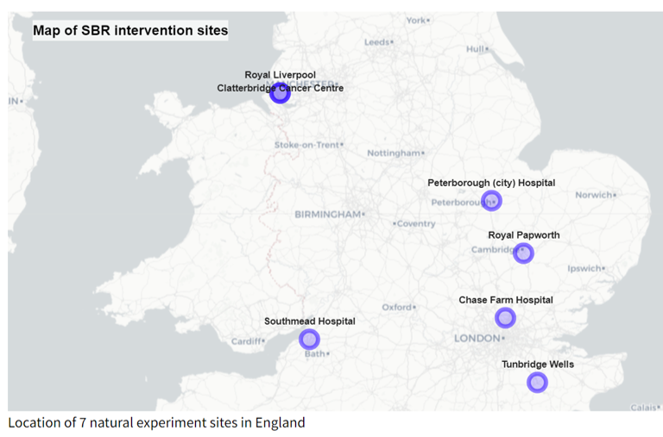
4.1 Seven natural experiments
Royal Liverpool (Oct 2022)
Clatterbridge Cancer Centre (June 2020)
Royal Papworth Hospital (May 2019)
Chase Farm Hospital (Sept 2018)
Southmead Hospital (May 2014)
Tunbridge Wells (Jan/Sept 2011)
Peterborough Hospital (Nov 2010)

Slide 18
4.2 Heterogeneity
No hospital site is the same as another. This is no more true than for our 7 natural experiments. The sites are a mixture of general acute hospitals and specialist ones. They vary in size and function and there are many possible confounding factors in the input-output logic model for our impacts that we can not identify nor account for.
In aggregating some of the findings in this analysis, we have grouped the general acute sites together for indicative purposes. However; the nature of those hospital systems and the social and cultural circumstance should be considerations when both interpreting our findings and also in considering single-bed provision within new hospital developments.

Slide 19
5. Summary of methods

Slide 20
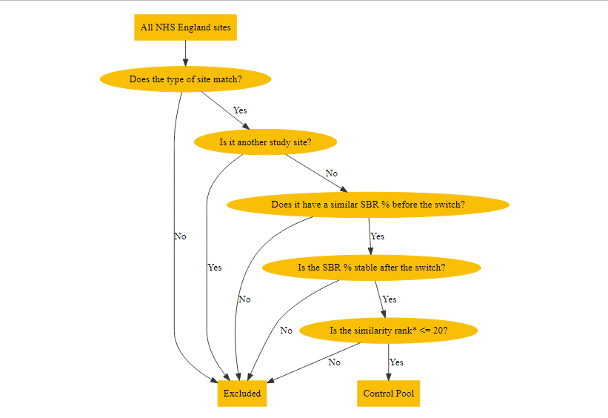
5.1 Selecting control sites
Before including control sites into the calculation of the post-intervention counterfactual, we must ensure they’re similar to the site under study. We do this in several consecutive steps:
Filter on similar site types e.g. General Acute, Tertiary Centre
Exclude those with dissimilar single bed %‘s at the point of ’intervention’
Match (on the closest 20) according to the following variables:
Hospital size (m2)
Patient case-mix (median age)
Elective:Non-elective spell ratio

Slide 21
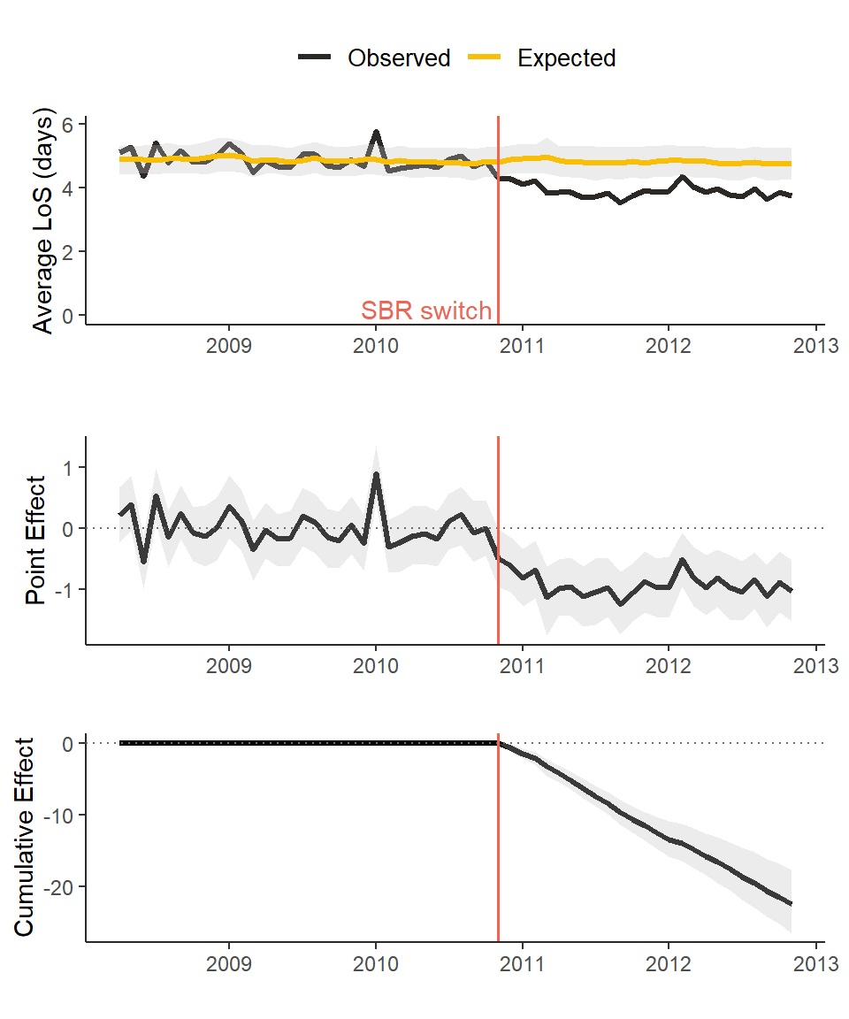
5.2 Causal Impact Analysis
Causal Impact Analysis (CIA), developed by K. Broderson in 2014, explicitly uses prior trends and ‘market-matched’ control analysis to predict a future time series. The observed values for the study site are compared to this prediction to determine the direction, magnitude and significance of impacts as a result of the intervention.
All our analysis has been performed in R software (v4.3.2+) with the following packages - CausalImpact, MarketMatching, dtw, metafor.
Example of CIA analysis

Slide 22
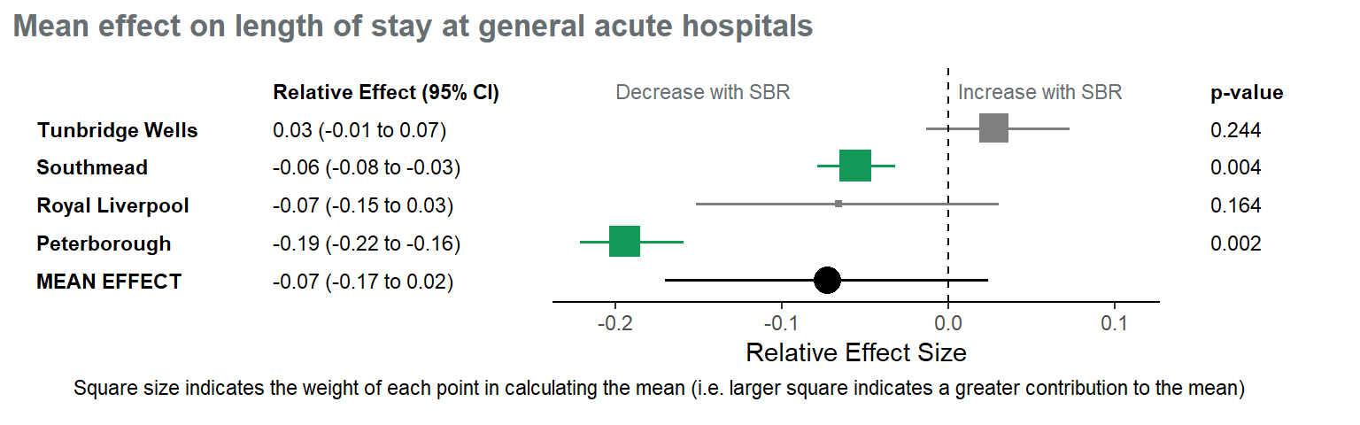
5.3 Aggregating impacts
Where for each impact measure there were 2 or more general and acute hospitals, a meta-analysis was conducted. The specialist hospital sites were excluded from this analysis as it is felt the effects at these sites may not be generalisable when considering future building of general acute hospitals.
A random-effects meta-analysis was conducted using the metafor R package (Viechtbauer 2024) and with the relative effects for each site weighted using the inverse variance, as used for meta-analysis of causal impact models by Schmitt et al. (Schmitt, Tull, and Atwater 2017).
Example of meta-analysis

Slide 23
6. Main results - Productivity and Efficiency

Slide 24
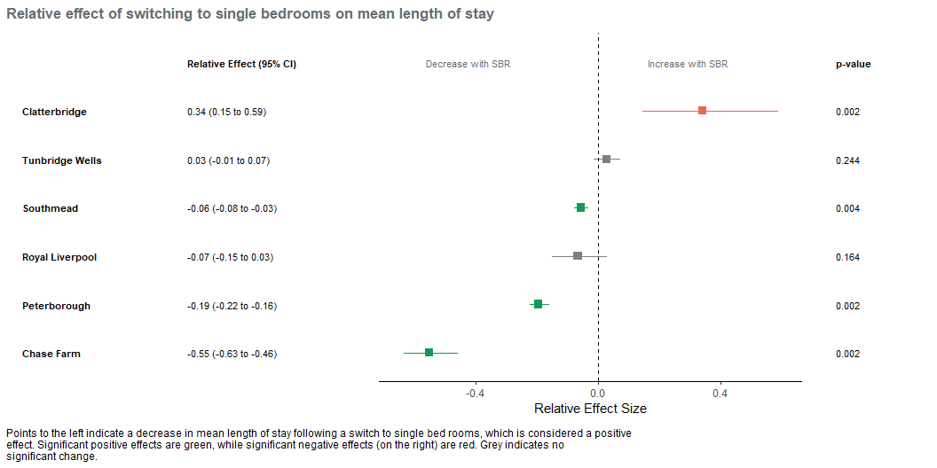
6.1 Length of stay
This monthly data at site level is derived from the Secondary Uses Service (SUS) admitted patients care spells.
Mean length of stay (in days) significantly decreased at 3/6 sites (Southmead, Peterborough and Chase Farm), was unchanged at 2/6 sites (Royal Liverpool and Tunbridge Wells), but significantly increased at Clatterbridge.

Slide 25
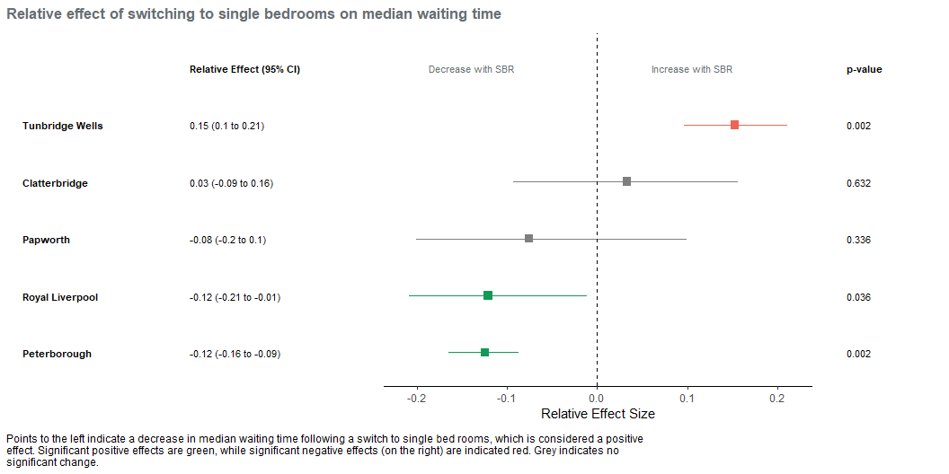
6.2 Waiting times
This monthly data at provider level is from published RTT waiting times dataset (via UDAL).
The median referral to treatment waiting time (in weeks) significantly decreased at 2/5 sites (Royal Liverpool and Peterborough) and was unchanged at 2/5 sites (Papworth and Clatterbridge) and increased at Tunbridge Wells.

Slide 26
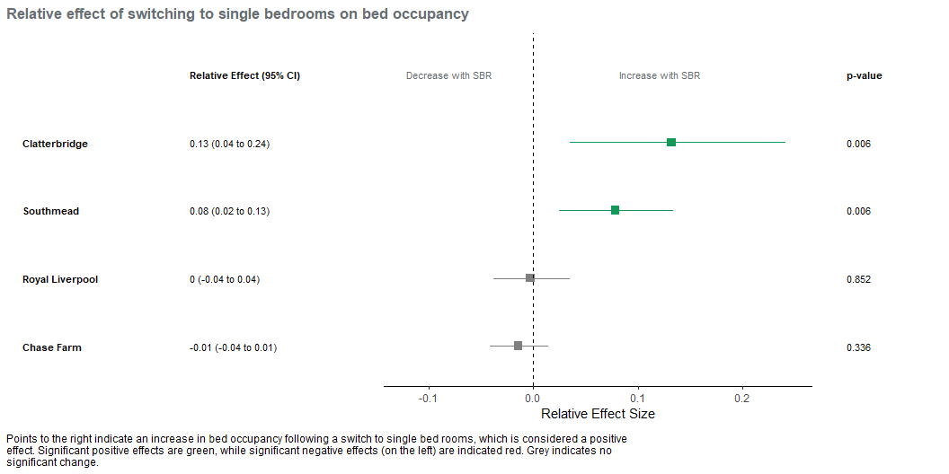
6.3 Bed Occupancy
This quarterly data at provider level is from published KH03 bed returns (via UDAL).
Bed occupancy is measured quarterly and is only available at a Provider level. The percentage of available beds occupied significantly increased at 2/4 sites (Clatterbridge and Southmead) and was unchanged at 2/4 (Royal Liverpool and and Chase Farm).

Slide 27
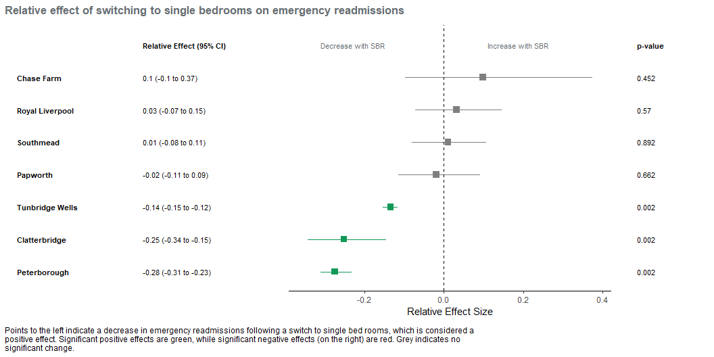
6.4 Emergency readmissions
This monthly data at site level is derived from SUS admitted patient care records.
The percentage of admissions that are emergency readmissions < 30 days of discharge significantly decreased at 3/7 sites (Tunbridge Wells, Peterborough and Clatterbridge) and was unchanged at the remaining 4/7 sites.

Slide 28
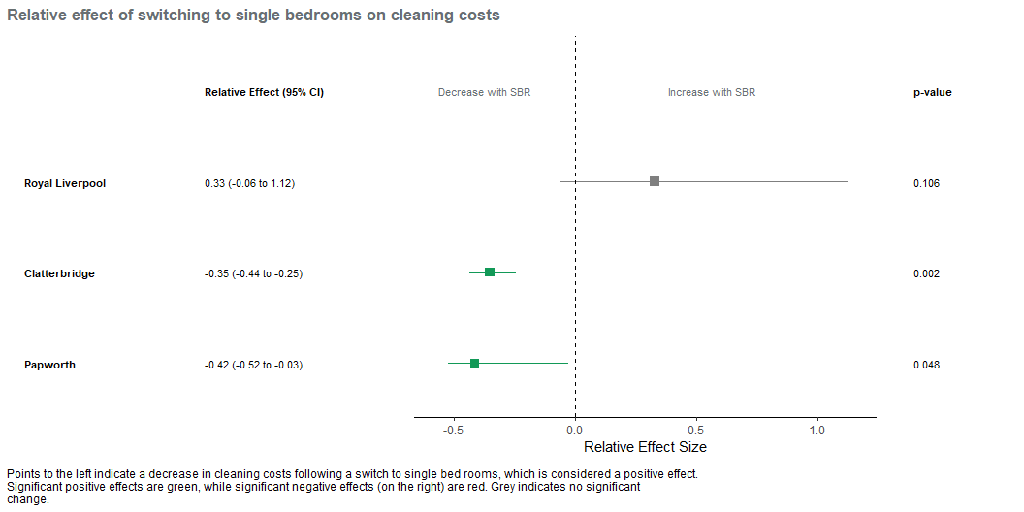
6.5 Cleaning costs
This annual data at site level is taken from published Estates Return Information Collection (ERIC) datasets.
The cleaning costs (in £) per square metre of occupied floor space significantly increased at 1/3 sites (Royal Liverpool) but decreased at 2/3 sites (Clatterbridge and Papworth).

Slide 29
7. Main results - Health and Safety

Slide 30
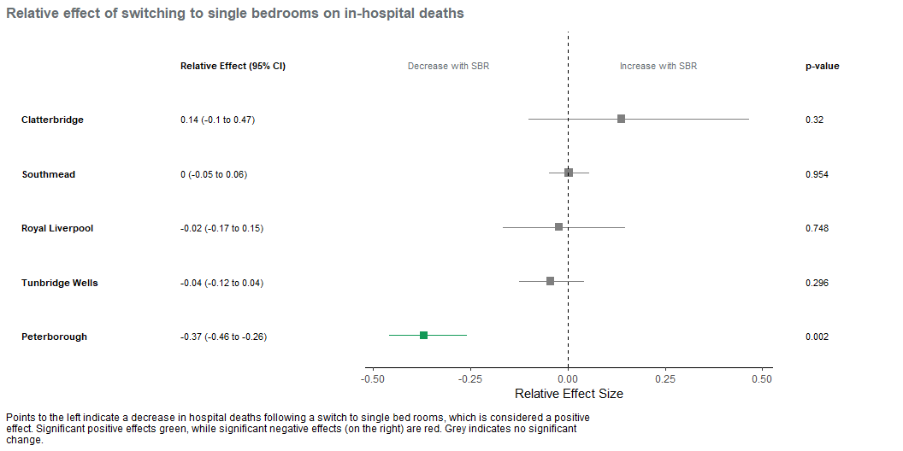
7.1 In-hospital deaths
This monthly data at site level is derived from SUS admitted patient care records.
The rate of in-hospital deaths (number per 1,000 discharges) significantly decreased at 1/5 sites (Peterborough), and was unchanged at 4/5 sites (Royal Liverpool, Tunbridge Wells, Clatterbridge and Southmead).

Slide 31
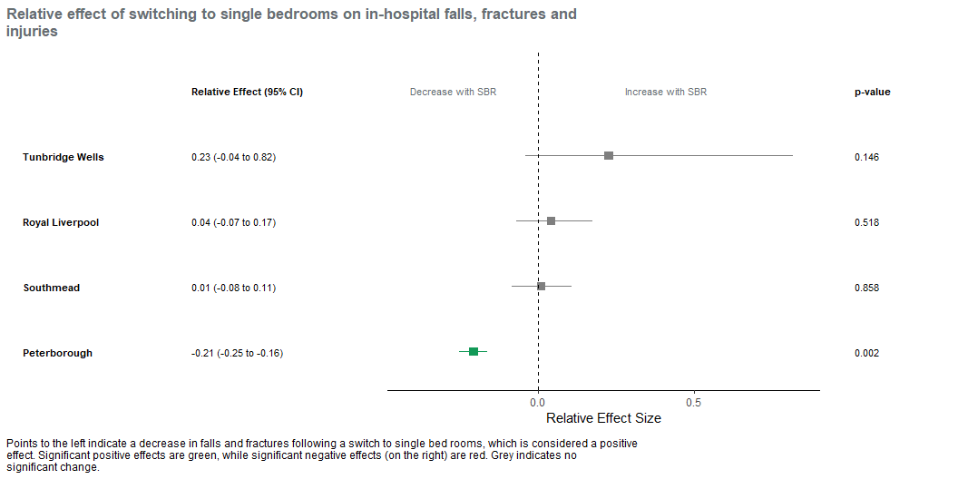
7.2 In-hospital falls and injuries
This monthly data at site level is derived from SUS admitted patient care records.
The rate of in-hospital falls and injuries (% of spells) significantly decreased at 1/4 sites (Peterborough), and was unchanged at 3/4 sites (Royal Liverpool, Tunbridge Wells and Southmead).

Slide 32
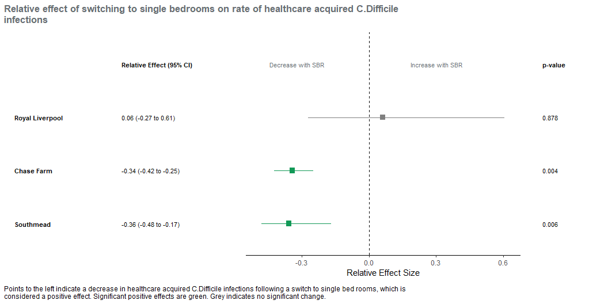
7.3 Healthcare Acquired Infections (HCAI) - clostridium dificile
This monthly data at provider level is taken from published UKHSA surveillance data (via UDAL).
The rate of healthcare acquired C. difficile infections (cases per 10,000 bed days) decreased at 2/3 sites (Chase Farm and Southmead) but was unchanged at Royal Liverpool.

Slide 33
8. Main results - Patient and Staff Experience

Slide 34
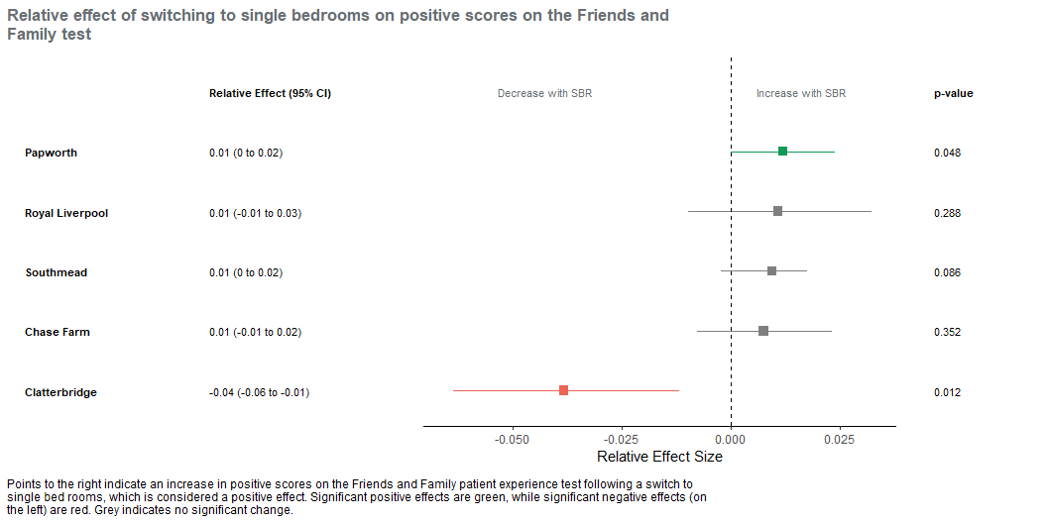
8.1 Family and Friends test
This monthly data at site level is taken from published NHS England data (via UDAL).
The percentage of positive responses significantly decreased at 1/5 sites (Clatterbridge), increased at 1/5 sites (Papworth) and was unchanged at the other 3/5 sites (Royal Liverpool, Southmead and Chase Farm).

Slide 35
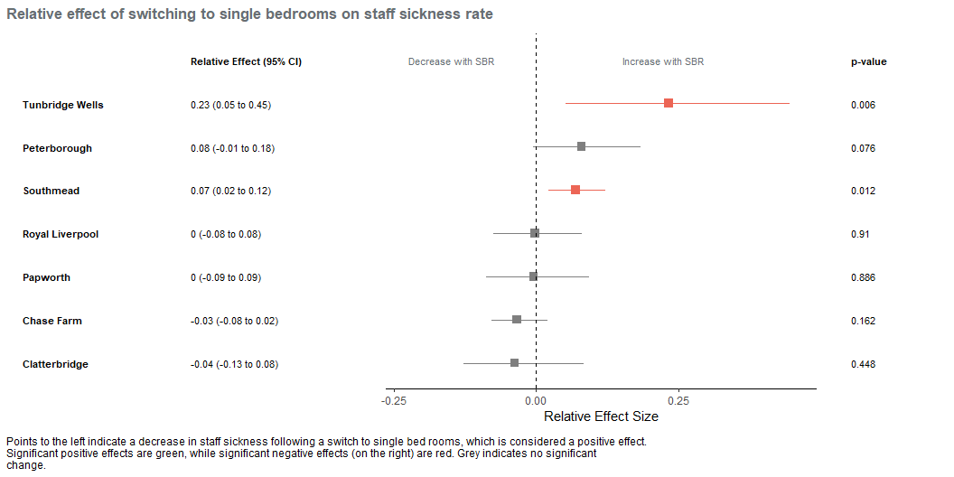
8.2 Staff sickness absence
This monthly data at provider level is taken from published NHS England data (via UDAL).
The percentage of available days taken off sick by staff significantly increased at 2/7 sites (Southmead and Tunbridge Wells) and was unchanged at the remaining 5 sites.

Slide 36
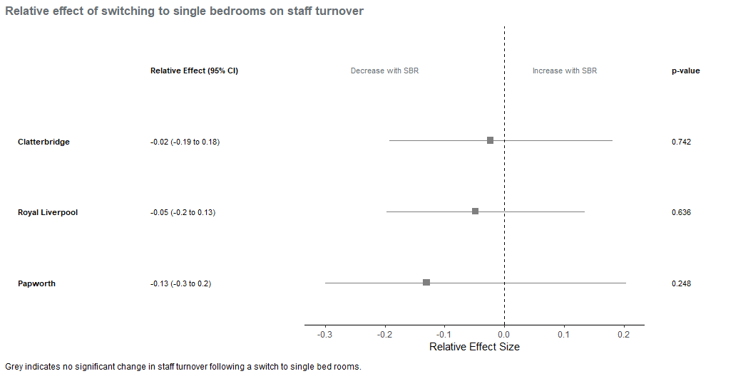
8.3 Staff turnover
This monthly data at provider level is taken from published NHS England data (via UDAL).
Staff turnover measured as percentage of staff leaving was not significantly changed at any of the 3 sites where data was available.

Slide 37
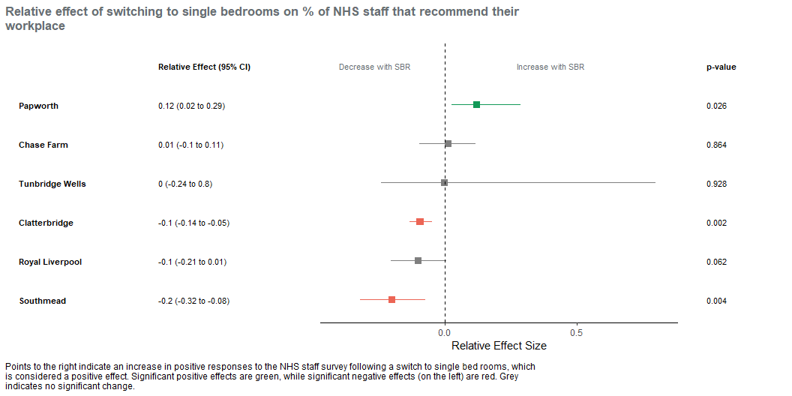
8.4 Staff survey - recommending place to work
This monthly data at provider level is taken from published NHS England data (via UDAL).
The percentage of staff that would recommend their trust as a place to work significantly increased at 1/6 sites (Papworth), and was unchanged at 3/6 (Chase Farm, Royal Liverpool and Tunbridge Wells). At 2/6 sites (Southmead and Clatterbridge) there was a significant decrease in the percentage that would recommend their trust as a place to work.

Slide 38
9. Next steps and actions

Slide 39
9.1 Ongoing and related activities
Discussing the NHP response to these findings (today’s session)
NHP planning and modelling teams consider findings for inclusion in assumptions and demand & capacity inflation and mitigation.
Supporting development of monitoring and evaluation framework for NHP/SBR.
Engage with the 7 providers in the study in terms of sharing of these findings in the public domain?
Consider regular (annual?) update of impact analysis for key indicators and inclusion of Midlands Met in retrospective review.

Slide 40
10. Acknowledgements

Slide 41
10.1 Acknowledgements
NHP programme: Cheryl Riotto, Anne White, Joanna Wood, Carolyn Akyil, Michael Weinbren
NHS England: Joshua Igbineweka, Paul Smith
Strategy Unit: Andy Hood, Sarah Lucas, Anya Ferguson, Peter Spilsbury, Simon Bourne, Jennifer Wood

